Slide 1
Four Years of Head Fakes
Spoons, Chiffarobes, Scuppernongs, Monsters, Myths, Murder, Miasmas, Adventure, Adversity, Anti-hero, Gerunds
and Mick Jenkins

Slide 2
The Hidden Curriculum
The JCPS Curriculum is what teachers are paid to teach you.
The basic ideas and texts that we are held responsible for presenting to you over four years.
The Hidden Curriculum is made up of the lessons teachers teach beneath their curriculum.
These are skills JCPS doesn’t care about, but your teachers ABSOLUTELY care about.

Slide 3
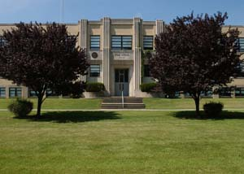
9th Grade

Slide 4
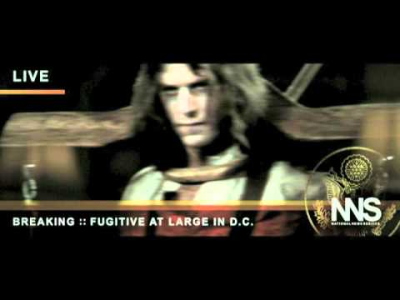

Slide 5
Harrison Bergeron
Hidden Curriculum:
  Individuality VS. Fitting In
  Fighting against bad leadership
  Not being apathetic about bad things in the world around you

Slide 6
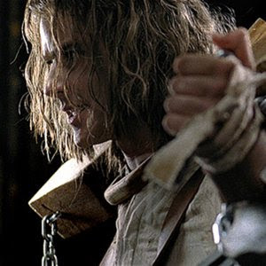
"We are nothing. Mankind is all. By the grace of our brothers are we allowed our lives. We exist through, by and for our brothers who are the State. Amen.“
Then we slept. The sleeping halls were white and clean and bare of all things save one hundred beds.
We, Equality 7-2521, were not happy in those years in the Home of the Students. It was not that the learning was too hard for us. It was that the learning was too easy. This is a great sin, to be born with a head which is too quick. It is not good to be different from our brothers, but it is evil to be superior to them. The Teachers told us so, and they frowned when they looked upon us.

Slide 7
Anthem
Hidden Curriculum:
  Individuality VS. Fitting In
  Refusing unjust laws
  Figuring out who you are

Slide 8
Night Jeopardy
Plot
Night Characters
Night Terminology
English Terms
Wild Card
Q $100
Q $100
Q $100
Q $100
Q $100
Q $200
Q $200
Q $200
Q $200
Q $200
Q $300
Q $300
Q $300
Q $300
Q $300
Q $400
Q $400
Q $400
Q $400
Q $400
Q $500
Q $500
Q $500
Q $500
Q $500
Final Jeopardy

Slide 9
One of the most tragic themes in Night is Elie's discovery of the way that cruel treatment can make good people act cruel as well. Does Elie himself escape this fate? Use specific events to defend your opinion.
Discuss why it is important to study the Holocaust and why it should not be forgotten. Be sure to include references to Night to support your argument.
Dehumanization is the process by which the Nazis reduced the Jews to little more than "things" to be destroyed. Discuss how dehumanization occurred in Night (you can include events that occurred that dehumanized Elie, his father, or his fellow Jews) and how this helped Hitler achieve his ultimate goal of destroying an entire race of people.
Often in novels, authors write with a purpose to teach the reader something about the subject. What lesson is Wiesel teaching in Night? Give examples from the story that support your claim

Slide 10
Night
Hidden Curriculum:
  The real and physical dangers of not caring
  The dangers of forgetting history
  The importance of understanding your government
  How scapegoating a group of people can lead to horrors

Slide 11
I willed myself to stay awake, but the rain was so soft and the room was so warm and his voice was so deep and his knee was so snug that I slept.
Seconds later, it seemed, his shoe was gently nudging my ribs. He lifted me to my feet and walked me to my room. “Heard every word you said,” I muttered. “…wasn’t sleep at all, ‘s about a ship an’ Three-Fingered Fred ‘n’ Stoner’s Boy…”
He unhooked my overalls, leaned me against him, and pulled them off. He held me up with one hand and reached for my pajamas with the other.
“Yeah, an‘ they all thought it was Stoner’s Boy messin’ up their clubhouse an‘ throwin’ ink all over it an‘…”

Slide 12
He guided me to the bed and sat me down. He lifted my legs and put me under the cover.
“An‘ they chased him ’n‘ never could catch him ’cause they didn’t know what he looked like, an‘ Atticus, when they finally saw him, why he hadn’t done any of those things… Atticus, he was real nice…”

Slide 13
His hands were under my chin, pulling up the cover, tucking it around me.
“Most people are, Scout, when you finally see them.”
He turned out the light and went into Jem’s room. He would be there all night, and he would be there when Jem waked up in the morning.

Slide 14
To Kill a Mockingbird
Hidden Curriculum:
  What great writing sounds like
  The importance of not judging a book by its cover
  The seriousness of the history of Race in the USA
  The importance of building respectful relationships
  Why not to dress up in a Ham costume
  The word Scuppernongs… pretty much

Slide 15
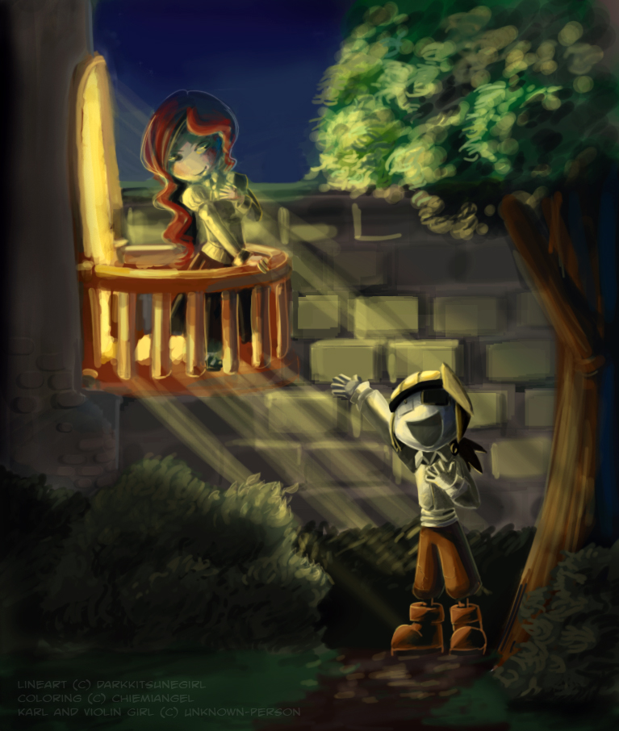
ACT 2
Scene Two

Slide 16
JULIET
Ay me!
ROMEO
(aside) She speaks.
O, speak again, bright angel! For thou art
As glorious to this night, being o'er my head,
As is a wingèd messenger of heaven
Unto the white, upturnèd, wondering eyes
Of mortals that fall back to gaze on him
When he bestrides the lazy-puffing clouds
And sails upon the bosom of the air.
JULIET
O Romeo, Romeo! Wherefore art thou Romeo?
Deny thy father and refuse thy name.
Or, if thou wilt not, be but sworn my love,
And I’ll no longer be a Capulet.
JULIET
Oh, my!
ROMEO
(to himself) She speaks. Oh, speak again, bright angel. You are as glorious as an angel tonight. You shine above me, like a winged messenger from heaven who makes mortal men fall on their backs to look up at the sky, watching the angel walking on the clouds and sailing on the air.
JULIET
(not knowing ROMEO hears her) Oh, Romeo, Romeo, why do you have to be Romeo? Forget about your father and change your name. Or else, if you won’t change your name, just swear you love me and I’ll stop being a Capulet.

Slide 17
Romeo and Juliet
Hidden Curriculum:
  What great writing sounds like
  The importance of defining what a “good” relationship is vs. a “bad” relationship
  The importance of good communication in relationships
    Spoilers, it was not great between R and J :D

Slide 18
World in the Balance
Yggdrasill, the world tree, spans the different realms of Norse myth.
These realms (Utgard, Midgard, Asgard) are joined by the three roots of the great tree Yggdrasill.
At its roots in Asgard is the well of Urd, where the Norns live; at its roots in Utgard is the well of Ymir.
It represents a world equilibrium:
Around its roots is a serpent;
At its top is an eagle;
A squirrel runs up and down between them;
Deer are constantly eating at its branches;
and the Norns continually try to shore up the damage.

Slide 19
Norse Mythology
Hidden Curriculum:
  History from a part of the world you didn’t know about
  How mythology impacts pop-culture
  How stories haven’t changed that much in thousands of years

Slide 20
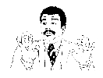


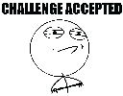
Family Tree of Egyptian Gods
Nu
Ra / Re
Atum
Shu
Tefnut
Geb
Nut
Nepthys
Osiris
Isis
Seth
Anubis
Horus
Notes:
Re was created from Nun (Nu). Atum was created from Re. Atum had twins, Shu and Tefnut. Shu and Tefnut were brother and sister and husband and wife. They had Geb and Nut, who were also brother and sister and husband and wife. They had Isis, Osiris, Nepthys, and Set. Osiris and Nepthys, also brother and sister, husband and wife had Horus.

Slide 21
Egyptian Mythology
Hidden Curriculum:
  History from a part of the world you didn’t know about
  How mythology impacts pop-culture
  How stories haven’t changed that much in thousands of years
  An excuse for Mr. Brewer to read aloud from the Egyptian Book of the Dead :D

Slide 22
Final 2 Weeks of School
Next Week
  Present Greek and Roman Projects
  Introduce Slam Poem Project
  LTAB Thursday and Friday
The Final Week
  Slam Poems and Intro to Sophomore Reading List and Work Level
  Slam Poems Recording Monday-Wednesday
Freshman Partay
  4th Period – Next Thursday
    Vote on Pizza or Ice Cream Cake
  Runner up period – June 3rd (while we record and listen to final Slam Poems)
  Third place – June 5th (while we record and listen to final Slam Poems)

Slide 23
Greek and Roman Mythology
Hidden Curriculum:
  History from a part of the world you didn’t know about
  How classical Greek and Roman Mythology and language effects our writing today
  How stories haven’t changed that much in thousands of years
  An excuse for Mr. Brewer to teach The Myth of Sisyphus for the first of two times :D

Slide 24
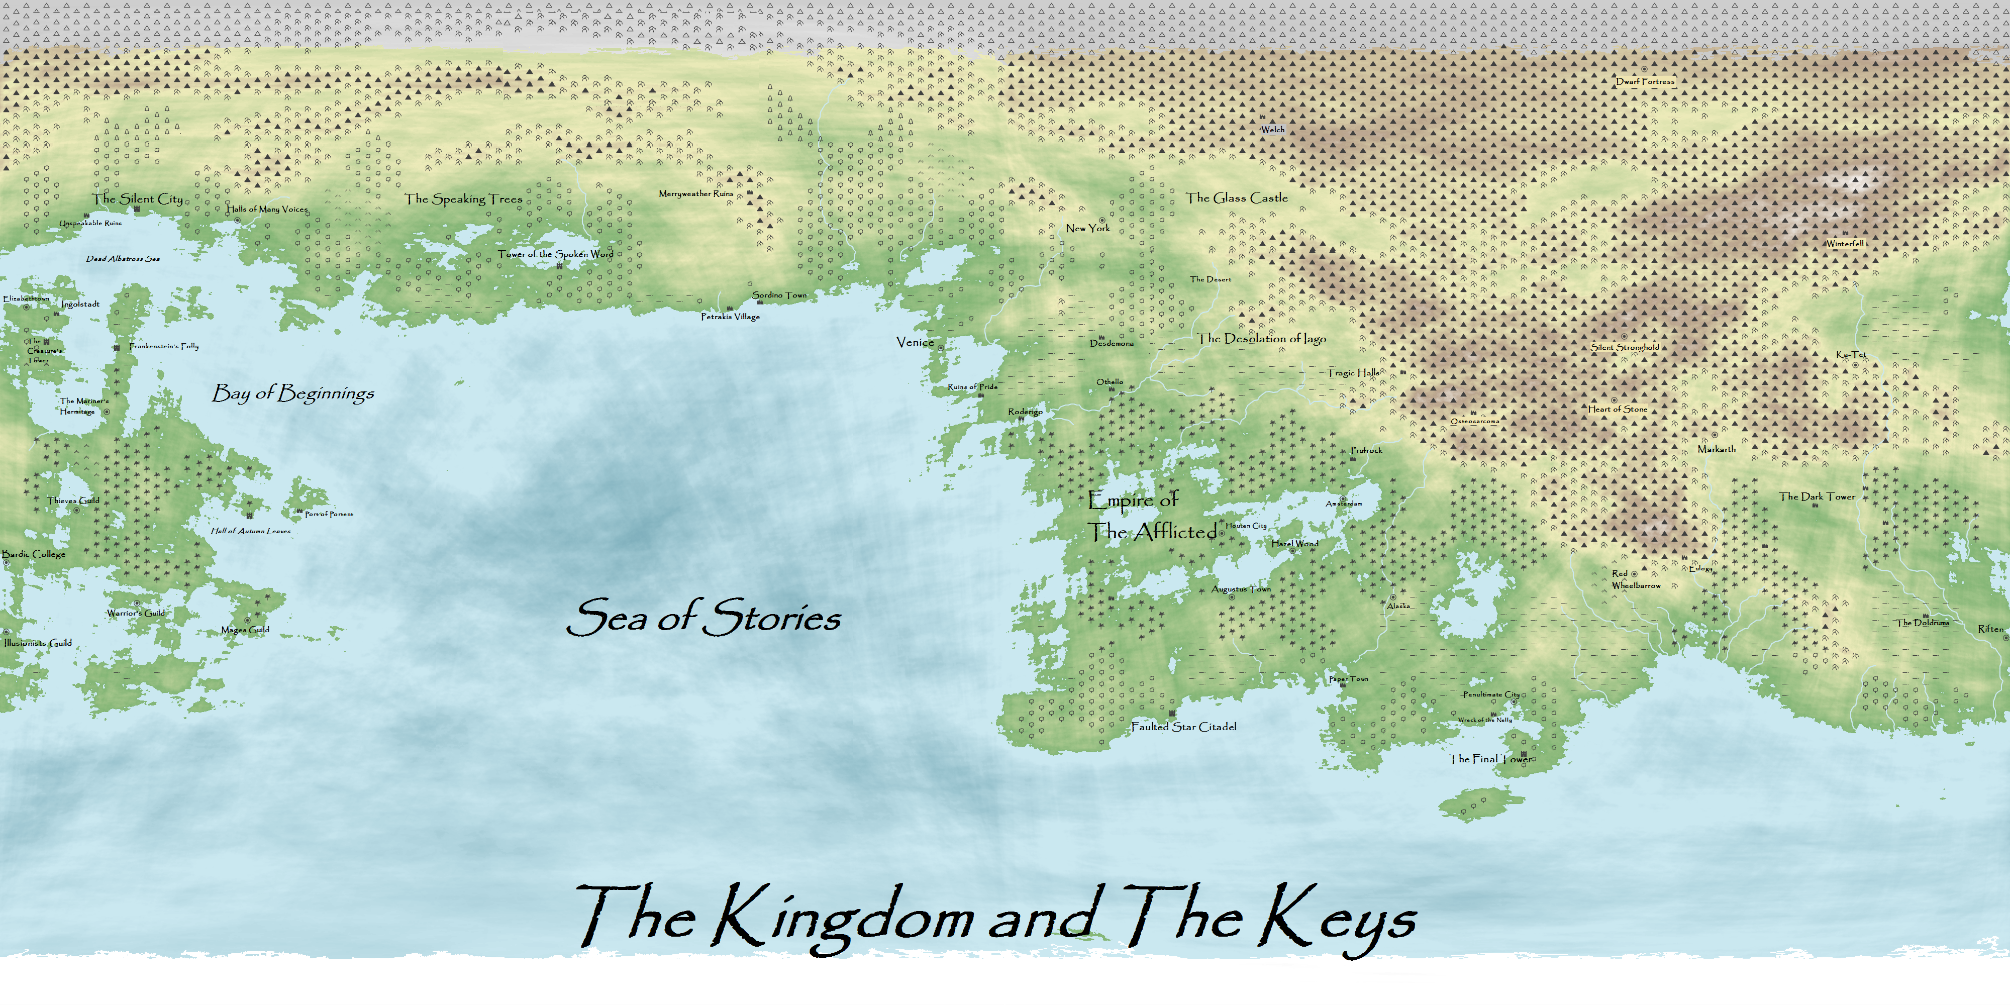
10th Grade

Slide 25
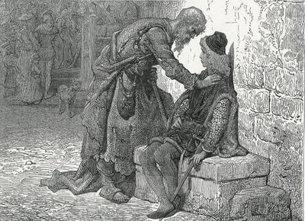
PART I
It is an ancient Mariner,
And he stoppeth one of three.
'By thy long grey beard and glittering eye,
Now wherefore stopp'st thou me?
The Bridegroom's doors are opened wide,
And I am next of kin;
The guests are met, the feast is set:
May'st hear the merry din.‘
He holds him with his skinny hand,
'There was a ship,' quoth he.
'Hold off! unhand me, grey-beard loon!'
Eftsoons his hand dropt he.
He holds him with his glittering eye—
The Wedding-Guest stood still,
And listens like a three years' child:
The Mariner hath his will.
Argument
How a Ship having passed the Line was driven by storms to the cold Country towards the South Pole; and how from thence she made her course to the tropical Latitude of the Great Pacific Ocean; and of the strange things that befell; and in what manner the Ancyent Marinere came back to his own Country.
An ancient mariner meeteth three gallants bidden to a wedding-feest and detaineth one.
The wedding-Guest is spellbound by the eye of the old seafaring man, and constrained to hear his tale.

Slide 26
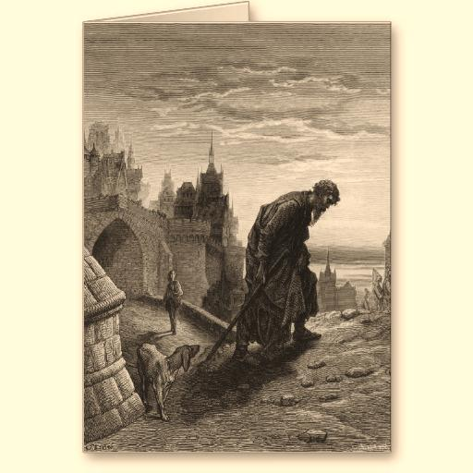
Forthwith this frame of mine was wrenched
With a woful agony,
Which forced me to begin my tale;
And then it left me free.
Since then, at an uncertain hour,
That agony returns:
And till my ghastly tale is told,
This heart within me burns.
I pass, like night, from land to land;
I have strange power of speech;
That moment that his face I see,
I know the man that must hear me:
To him my tale I teach.
What loud uproar bursts from that door!
The wedding-guests are there:
But in the garden-bower the bride
And bride-maids singing are:
And hark the little vesper bell,
Which biddeth me to prayer!
And ever and anon throughout his future life and agony constraineth him to travel from land to land;

Slide 27
The Rime of the Ancient Mariner
Hidden Curriculum:
  You can break rules without knowing there are rules
  You are accountable for your actions
  Your actions affect other people
  Some things go without saying
  There was a ship!

Slide 28
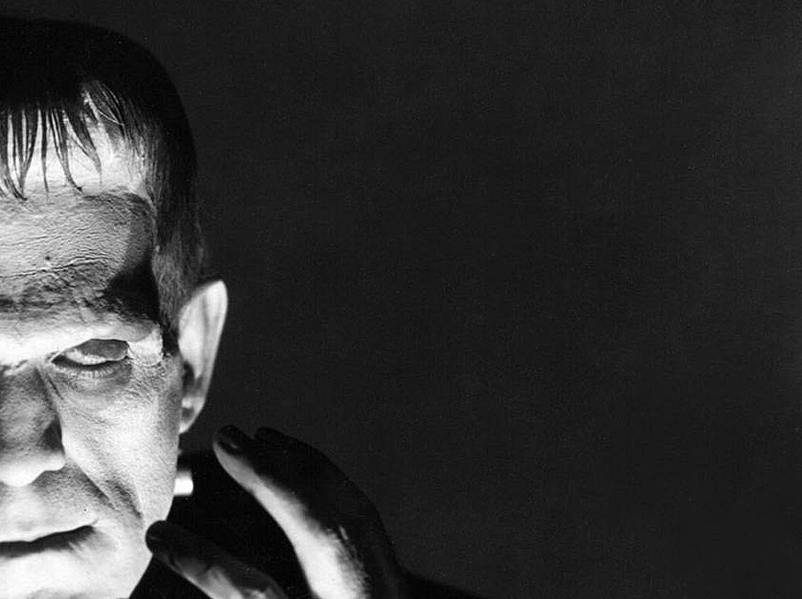
Frankenstein or
The
Modern Prometheus
Written by: Mary Shelly
Translated to Awesome for Phoenix by: Mr. Brewer

Slide 29
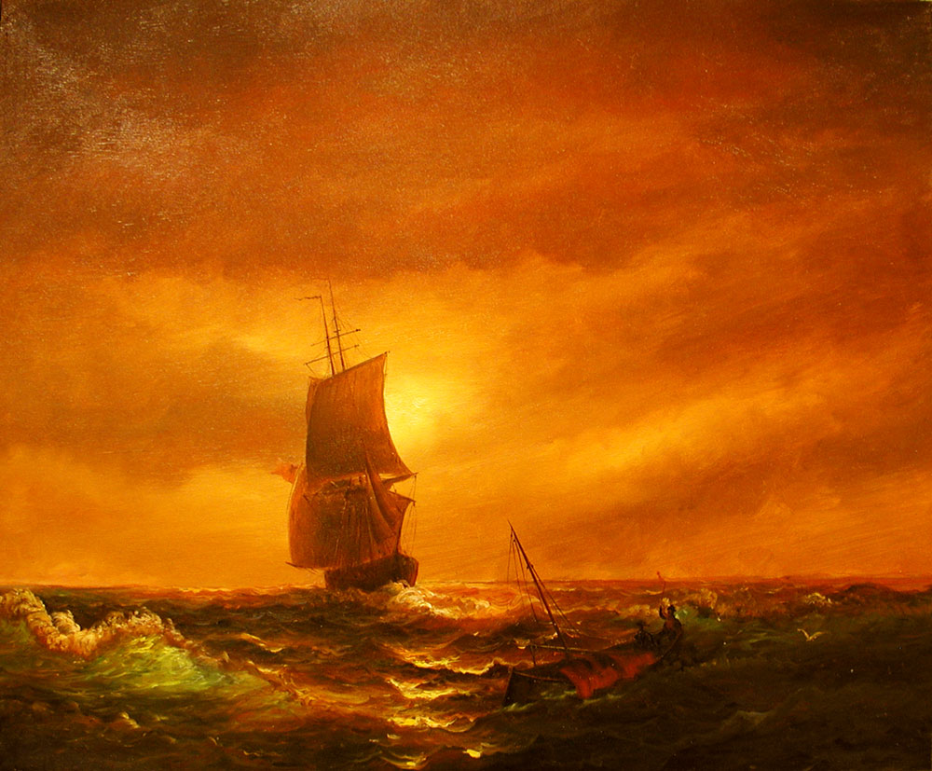
This expedition has been the favorite dream of my early years. I have read with enthusiasm the accounts of the various voyages which have been made in the prospect of arriving at the North Pacific Ocean through the seas which surround the pole. You may remember that a history of all the voyages made for purposes of discovery composed the whole of our good Uncle Thomas' library.
My education was neglected, yet I was passionately fond of reading. These volumes were my study day and night, and my familiarity with them increased that regret which I had felt, as a child, on learning that my father's dying command had forbidden my uncle to allow me to embark in a seafaring life.

Slide 30
Frankenstein
Hidden Curriculum:
  The happiness of those around you should be a goal, not a side-effect of your work
  Your actions affect other people
  Who you are is what you do. Not what you think or intend to do.

Slide 31
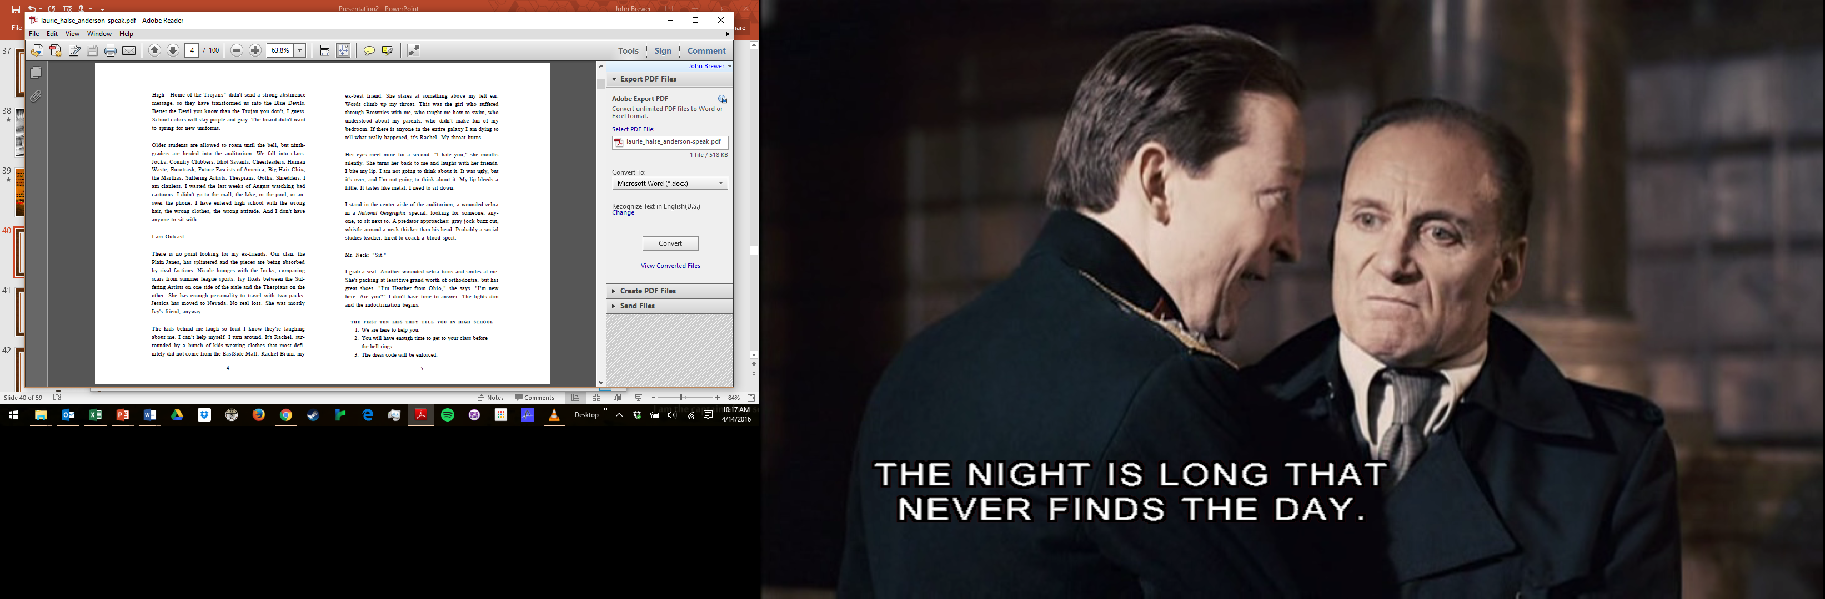

Slide 32
Welcome to English Class!
11-20-13
Independent Reading
  15 Minutes
IR question and discussion
  5 minutes
Speak, (FILL IN THE BLANK!) to Giving Thanks
  15 minutes
Speak Discussion
  5 minutes
Journal / Closing
  10 minutes
Free Rice Vocab builder
  10 minutes
Today’s Standards are:
QC A5. e: Identify, analyze, and evaluate the ways in which the devices the author chooses (e.g., irony, imagery, tone, sound techniques, foreshadowing, symbolism) achieve specific effects and shape meaning in increasingly challenging texts.
Today’s Independent Reading Question is:
Give two examples (one of each) of simile and metaphor from your text.
Today’s Journal Prompts are:
What are you willing to speak / stand out about?
Or
What topics are worth defending and why?

Slide 33
Speak
Hidden Curriculum:
  You never know what people are carrying around unless they tell you
  Everyone’s cup is different for suffering
  You can’t control everything that happens to you, you CAN control your response.

Slide 34
Four score and seven years ago our fathers brought forth on this continent, a new nation, conceived in Liberty, and dedicated to the proposition that all men are created equal.
Now we are engaged in a great civil war, testing whether that nation, or any nation so conceived and so dedicated, can long endure. We are met on a great battle-field of that war. We have come to dedicate a portion of that field, as a final resting place for those who here gave their lives that that nation might live. It is altogether fitting and proper that we should do this.
But, in a larger sense, we can not dedicate -- we can not consecrate -- we can not hallow -- this ground. The brave men, living and dead, who struggled here, have consecrated it, far above our poor power to add or detract. The world will little note, nor long remember what we say here, but it can never forget what they did here. It is for us the living, rather, to be dedicated here to the unfinished work which they who fought here have thus far so nobly advanced. It is rather for us to be here dedicated to the great task remaining before us -- that from these honored dead we take increased devotion to that cause for which they gave the last full measure of devotion -- that we here highly resolve that these dead shall not have died in vain -- that this nation, under God, shall have a new birth of freedom -- and that government of the people, by the people, for the people, shall not perish from the earth.
Abraham Lincoln - November 19, 1863

Slide 35
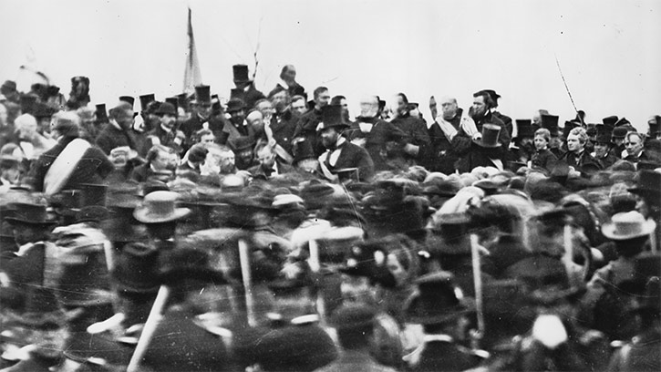

Slide 36
Great Speeches
Hidden Curriculum:
  Words have the power to change everything about our world
  Your own words can build or destroy
  Voelker – You can speak words of creation or destruction.

Slide 37
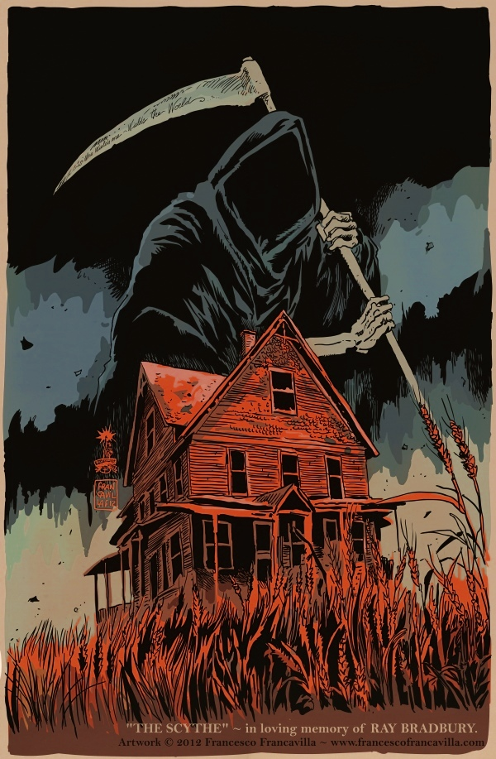

Slide 38
The Scythe
Hidden Curriculum:
  Your actions have an impact you may not even know
  What great spooky writing looks like

Slide 39
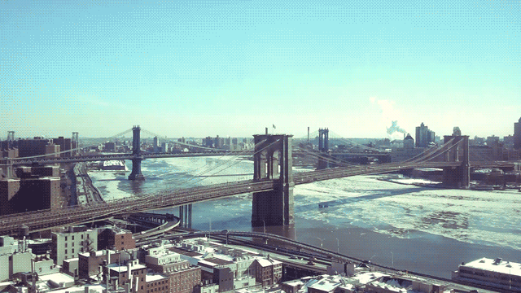
Welcome to English Class!
03-12-14
Glass Castle Final Discussion
Letter to Jeannette Walls due Friday
Independent Reading / Optioned Work Time
Today’s Standards are:
CC – Review
CC – Lit
CC – Daily Writing
No Independent Reading Today
Choose your HW Option for this week.
Today’s Journal Prompts are:
No Freewrite Today
OR
Respond to the prompt in your reading

Slide 40
The Glass Castle
Hidden Curriculum:
  Your attitude determines not only your happiness, but sometimes your very survival
  You never know what someone else has gone through
    Starting to see a theme?
  Everyone’s cup for suffering is different
  You are not your parents. You are you.

Slide 41
Read Act 4
Scene One PER 2
As we read we will need volunteers to read the characters…
  Cassio – A friend of Othello and secretly thinks Desdemona is beautiful
  Swank Master Raww
  Iago – Still really, really, really freaking evil
  Dr. Canfield
  Bianca – Cassio’s girlfriend who is also a... Lady of the night.
  Dr. Caudill
  Othello – Our increasingly furious main character, who is decreasing in love with Desdemona as the play goes on
  Various Buckner
  Desdemona – is still in love with Othello
  Dr. Fuzzy Boots
  Ludovico – Desdemona’s cousin from Venice, also an important guy in the city (remember, her dad is a Senator).
  Dyukasaurus Ren

Slide 42
Read Act 4
Scene One PER 3
As we read we will need volunteers to read the characters…
  Cassio – A friend of Othello and secretly thinks Desdemona is beautiful
  Dr. Steiner
  Iago – Still really, really, really freaking evil
  Dr. Roberts
  Bianca – Cassio’s girlfriend who is also a... Lady of the night.
  Dr. Raven
  Othello – Our increasingly furious main character, who is decreasing in love with Desdemona as the play goes on
  Mr. Brewer
  Desdemona – is still in love with Othello
  Dr. Noblesse Oblige
  Ludovico – Desdemona’s cousin from Venice, also an important guy in the city (remember, her dad is a Senator).
  Dr. McClain

Slide 43
Read Act 4
Scene One PER 5
As we read we will need volunteers to read the characters…
  Cassio – A friend of Othello and secretly thinks Desdemona is beautiful
  Dr. Lawrence
  Iago – Still really, really, really freaking evil
  Dr. Monroe
  Bianca – Cassio’s girlfriend who is also a... Lady of the night.
  Dr. Taylore
  Othello – Our increasingly furious main character, who is decreasing in love with Desdemona as the play goes on
  Dr. Skittles
  Desdemona – is still in love with Othello
  Dr. Pandas
  Ludovico – Desdemona’s cousin from Venice, also an important guy in the city (remember, her dad is a Senator).
  Dr. Szerletich

Slide 44
IAGO
Demand me nothing. What you know, you know.
From this time forth I never will speak a word.
IAGO
Don’t ask me anything. You know what you know. From this moment on, I’ll never say another word.

Slide 45
Othello
Hidden Curriculum:
  Some people are so broken they only hurt other people
  Jealousy and Fear are the roots of hatred and cruelty
  Keep your BF’s handkerchiefs somewhere where they can easily be found!!!
  Even if you overcome crazy obstacles, people may be jealous still and push back

Slide 46
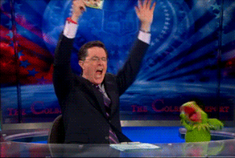
Welcome to English Class!
05-05-14
Puzzle Master?
  4 minutes
TFIOS Reading #8
  20 minutes
Optioned Work Time
  20-30 minutes
EOC Prep Quiz
  Last 10 minutes
Today’s Standards are:
CC – Review
CC – Lit
CC – Daily Writing
No Independent Reading Today
HW Due today for a grade
Puzzle Master?!
Four of us are in your field
But our differences keep us at yield
First, a one that is no fool
Though he resembles a gardener's tool
Next, one difficult to split in two
And a girl once had one as big as her shoe
Then, to the mind, one's a lovely bonder
And truancy makes it grow fonder
Last, a stem connecting dots of three
Knowing all this, what are we?

Slide 47
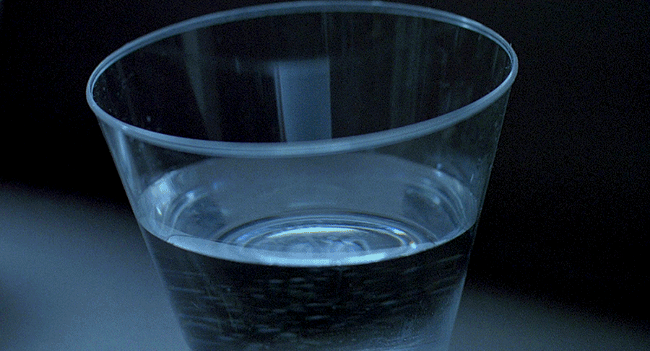
Welcome to English Class!
Today’s Standards are:
CC – Review
CC – Lit
CC – Daily Writing
K-Prep Review
06-02-14
XP CAKE RACE
  Rest of class
All Makeup work is due by Wednesday
  Class
1st Class to 50 gets an Ice Cream Cake Party
Highest class on Friday gets a 5 level boost at the beginning of the game next year.
No Independent Reading Today
All makeup work due by Wednesday
www. kingdomandkeys.com
RACE FOR THE CAKE
Today’s Double XP Project is...
!The Artist!

Slide 48
The Fault in Our Stars
Hidden Curriculum:
  Love has the capacity to
  Metaphors
  You can learn from people who aren’t nice
  Cancer sucks
  Value your relationships, they aren’t forever
  How to egg a house while blind

Slide 49
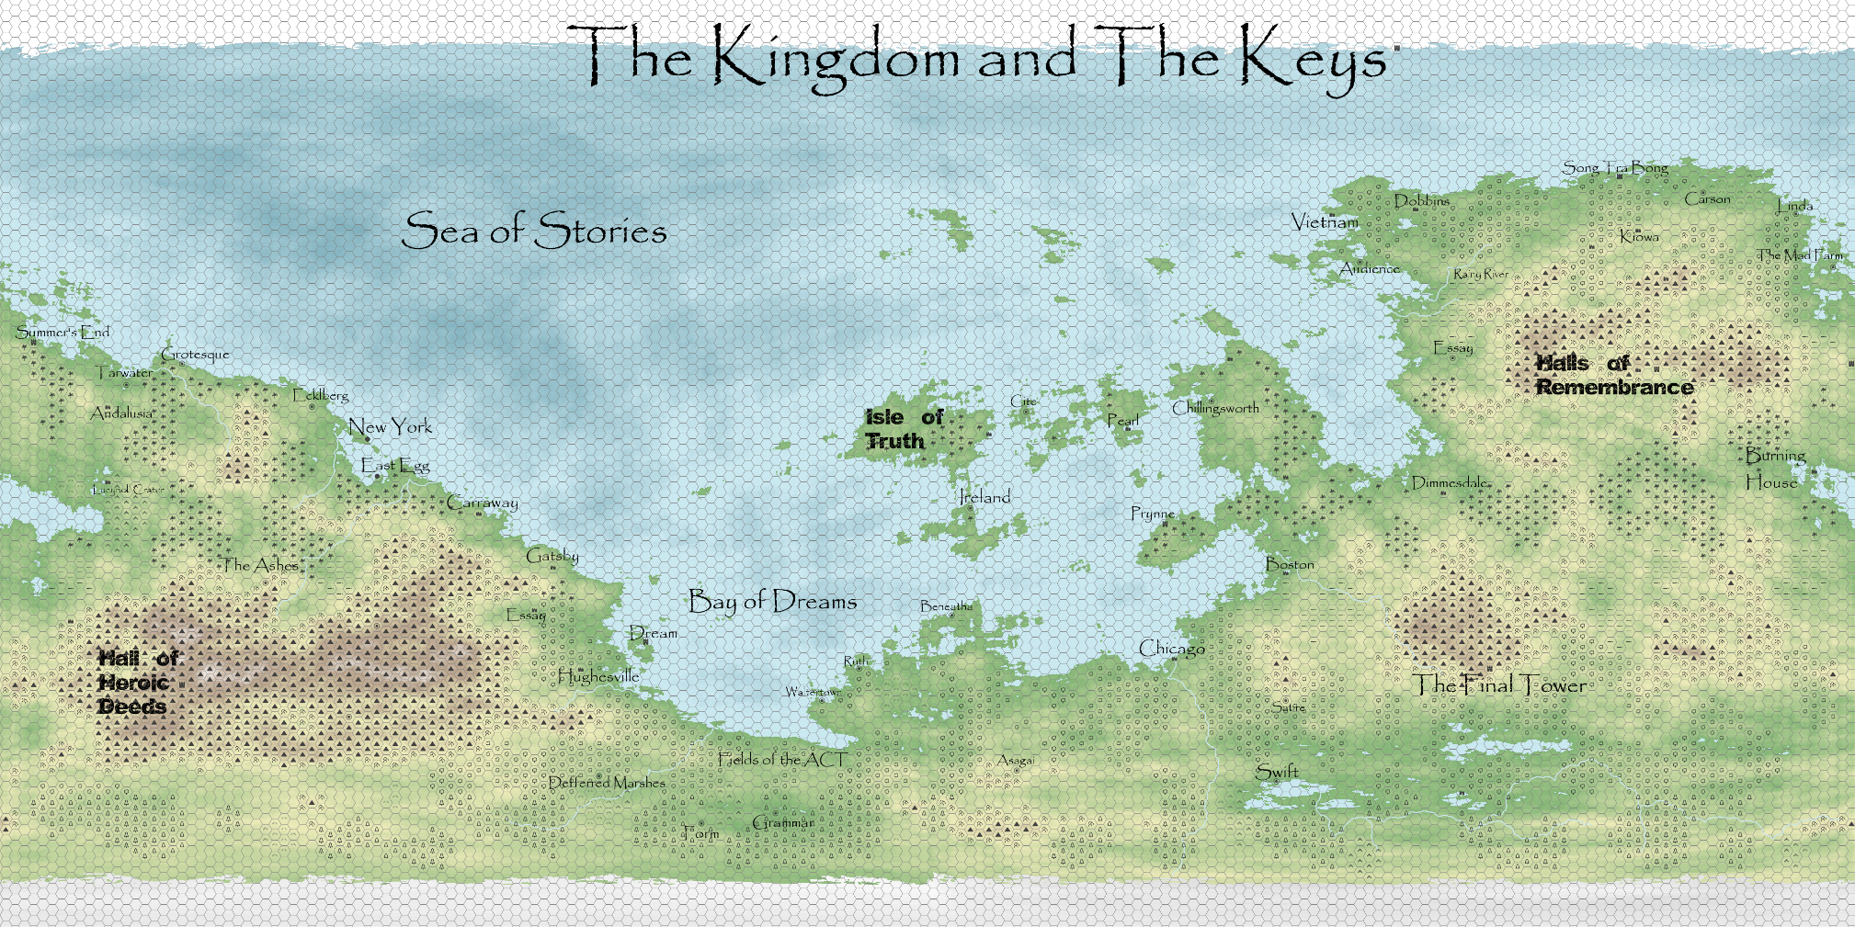
11th Grade

Slide 50
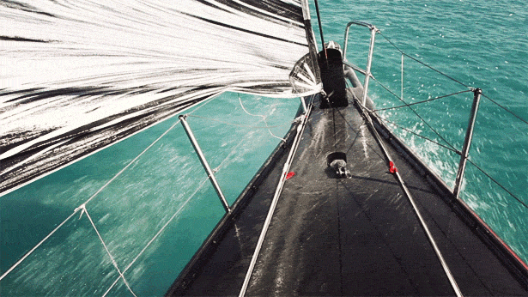
Welcome to 11th Grade English Class!
Today’s Standards are:
analyze(RL/I.11-12.1)
central idea (RL/I.11-12.2)
08-20-14
Wednesday Video Discussion Opening
  View, write your response, and we will discuss
  5-10 minutes
Independent Reading
  Answer IR Questions and Class Competition check in
  20 Minutes
The Life You Save May Be Your Own
  Class Reading
  Answer questions on the worksheet
  20-30 minutes
Daily Journal
  Respond to the question on the board
  10 minutes
Optioned HW Work time
  If any time left
  Rest of Class
Independent Reading Questions
5XP = 1 paragraph example of alliteration, rhyming, or hyperbole
6XP = 2 examples. Simile or Metaphor
Today’s Journal Prompt is:
Do we find or create our true selves?

Slide 51
The life you save may be your own
Hidden Curriculum:
  Sometimes there is no hero
  Real life can be grotesque
  Most of the time in real life, meaning is hard to find

Slide 52


Slide 53

Then wear the gold hat, if that will move her;
If you can bounce high, bounce for her too,
Till she cry "Lover, gold-hatted, high-bouncing lover,
I must have you!"
--THOMAS PARKE D'INVILLIERS

Slide 54
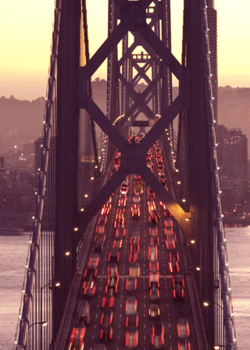
Chapter One

Slide 55
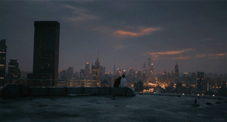
In my younger and more vulnerable years my father gave me some advice that I've been turning over in my mind ever since.
"Whenever you feel like criticizing any one," he told me, "just remember that all the people in this world haven't had the advantages that you've had."

Slide 56
The Great Gatsby
Hidden Curriculum:
  The love of your life needs to be worthy of your love
  You can’t judge a book by its cover
  It isn’t enough that you “make it big,” HOW you make it matters, too.
  A house with no foundations doesn’t stand

Slide 57

5 XP Question from Act 3
What does Mama grab before leaving at the end of the last scene of the play?
What could this item represent?

Slide 58
5 XP Answer from Act 3
Her potted plant
Her hopes and dreams

Slide 59
A Raisin in The Sun
Hidden Curriculum:
  In this country, everyone does not get an equal start, even though it is in the constitution
  Your dreams can crush you, if you don’t have a way to attain them realistically
  Your dreams have requirements that you must meet for them to come true
  If you work below your ability, you will be unfulfilled and unhappy

Slide 60
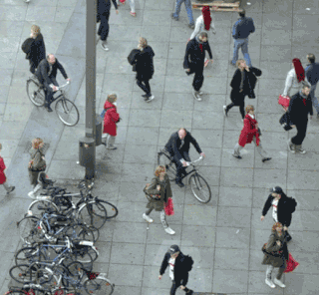
Welcome to Junior English!
Today’s Learning targets are:
We can understand the themes and characters of Arthur Miller’s The Crucible
We can produce a written project once a week that reflects our individuality as well as our ability in Written English
01-28-2015
Wednesday
Independent Reading / Daily Journal
  15 minutes
The Crucible Reading #13
Work on HW #9
  One HW is due each week
  12 are due by the end of the 12 weeks
  If you are finished with your 9th HW assignment, move on to your 10th
  If you are finished with all 12 of them, you are a BAUS
Independent Reading Guiding Question:
Purpose Day.
Describe the purpose of your text.
5XP for four complete sentences in your response.
Daily Journal Prompt:
What does it mean to be a “Just” person?

Slide 61
The Crucible
Hidden Curriculum:
  When logic is thrown out by governments, people suffer
  When a few people control everything, it is dangerous to disagree with them
  Free speech and free thought are only possible if power is distributed
  Religion and Government don’t mix well
  Sometimes, adversity shows us who we really are, and reminds us of what really matters

Slide 62
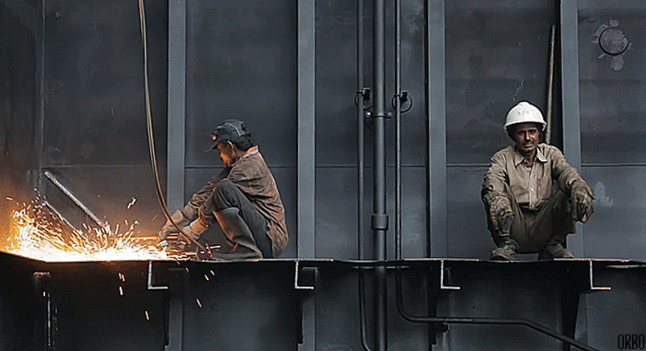
Welcome to Junior CW!
Today’s Learning targets are:
We can understand the themes and characters of The Things They Carried and Prepare for the ACT
We can produce a written project once a week that reflects our individuality as well as our ability in Written English
02-24-2015
Tuesday
Independent Reading / Daily Journal / Crucible Essay Work
  15 minutes
TTTC Reading #3
  Rest of Class
Independent Reading Guiding Question:
Tone Day. Describe the tone of your text.
5XP for four complete sentences in your response.
Daily Journal Prompt:
How do we make meaning out of events?

Slide 63
The Things They Carried
Hidden Curriculum:
  Everyone carries something with them that you don’t know about, a hidden weight.
  This makes them stronger, as well as tired, on different days.
  Sometimes, writing can raise the dead.
  Fiction can sometimes be more true than non-fiction
  Vietnam was hellish

Slide 64
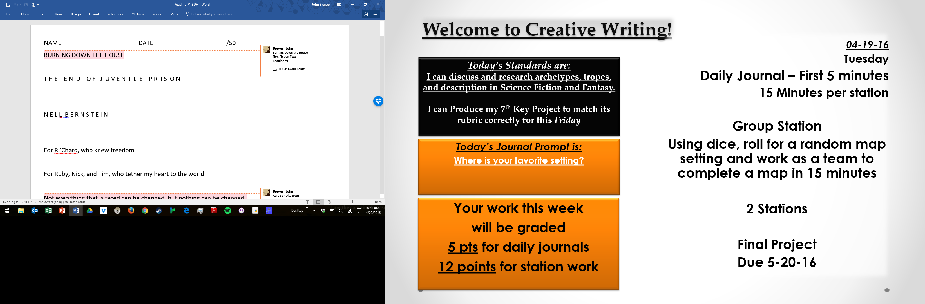

Slide 65
Burning Down the House
Hidden Curriculum:
  Today in the USA young adults are held in solitary confinement for DAYS on end in Juvenile Detention Facilities
  Our Government can make mistakes that cost people their lives and their minds
  The only way to prevent the above is to READ, GET ANGRY, and VOTE

Slide 66
Introduction to Poetry
“In a poem the words should be as pleasing to the ear as the meaning is to the mind.” -- Marianne Moore

Slide 67
The Human Brain
Divided into 2 parts
Each half has its own function
Right Brain:
Creativity
Emotions
UNQUENCHABLE RAGE
Left Brain:
Logic
Reality
WARM FUZZIES

Slide 68
Louder Than a Bomb
Hidden Curriculum:
  Poetry can present the strongest emotions we have
  Poetry is language that is designed to convey emotion more than detail
  The points AREN’T the point, the point is the POETRY!

Slide 69
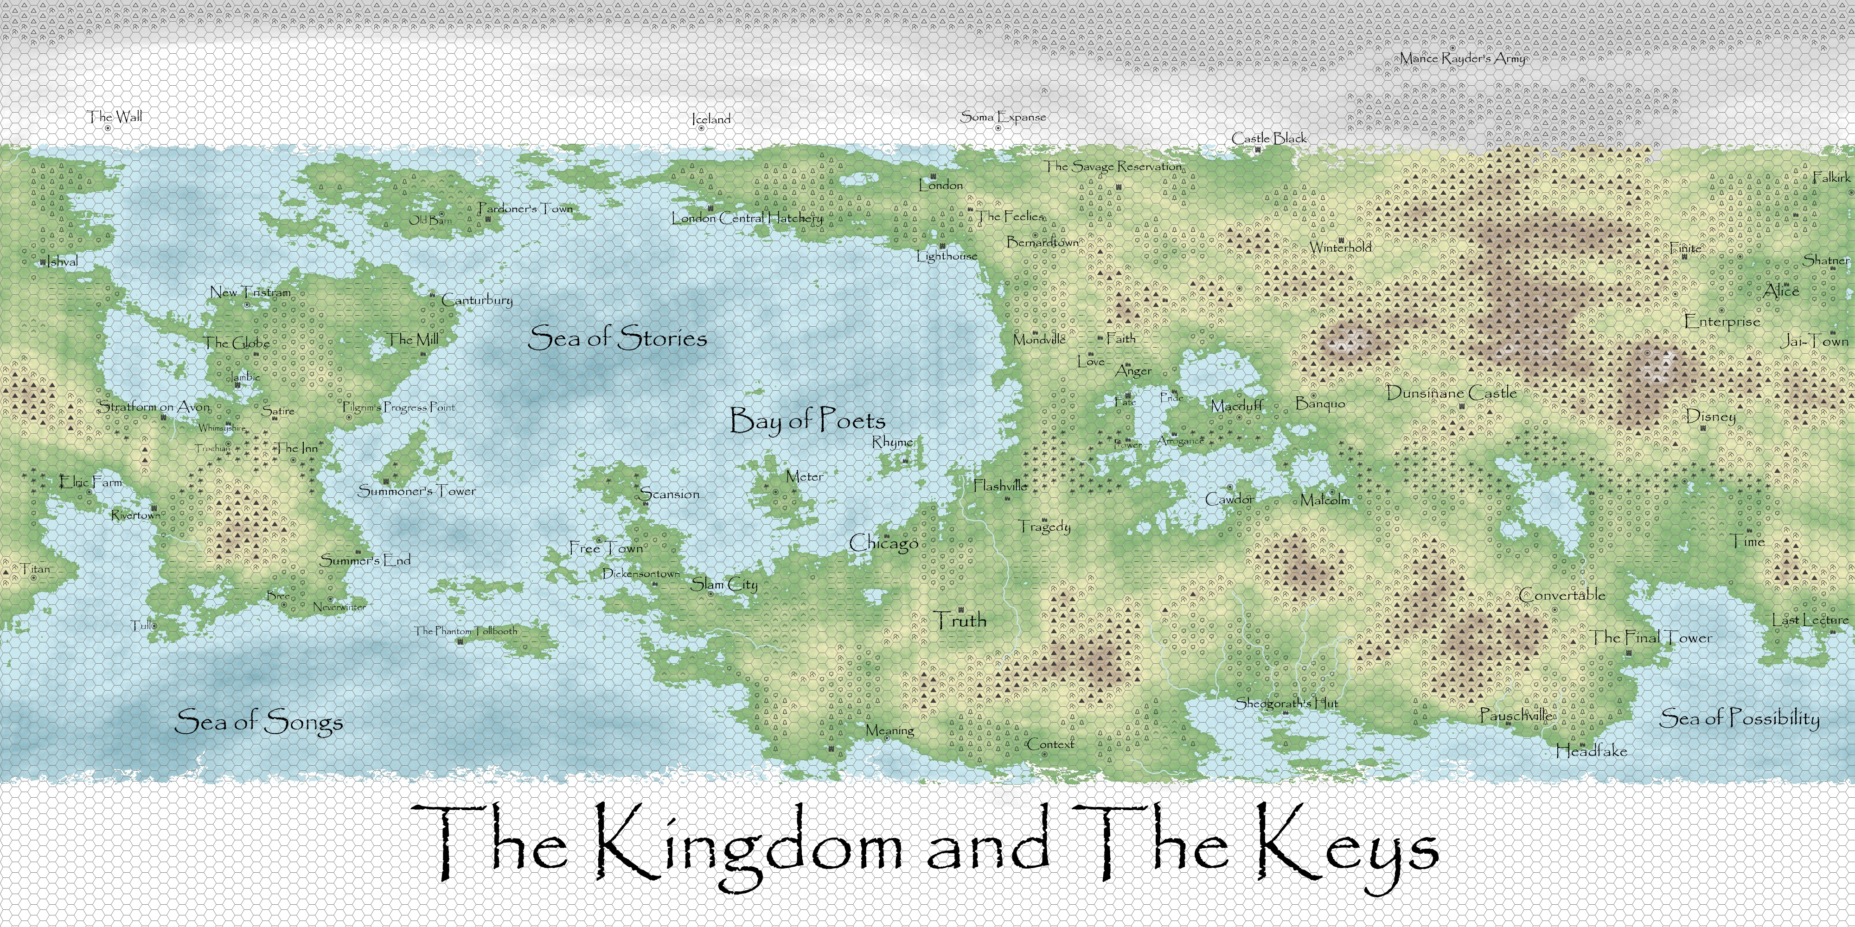
12th Grade

Slide 70
The Canterbury Tales
Hidden Curriculum:
  If you are going to make fun of the people in power, don’t be obvious
  People have ALWAYS made fun of the powerful

Slide 71
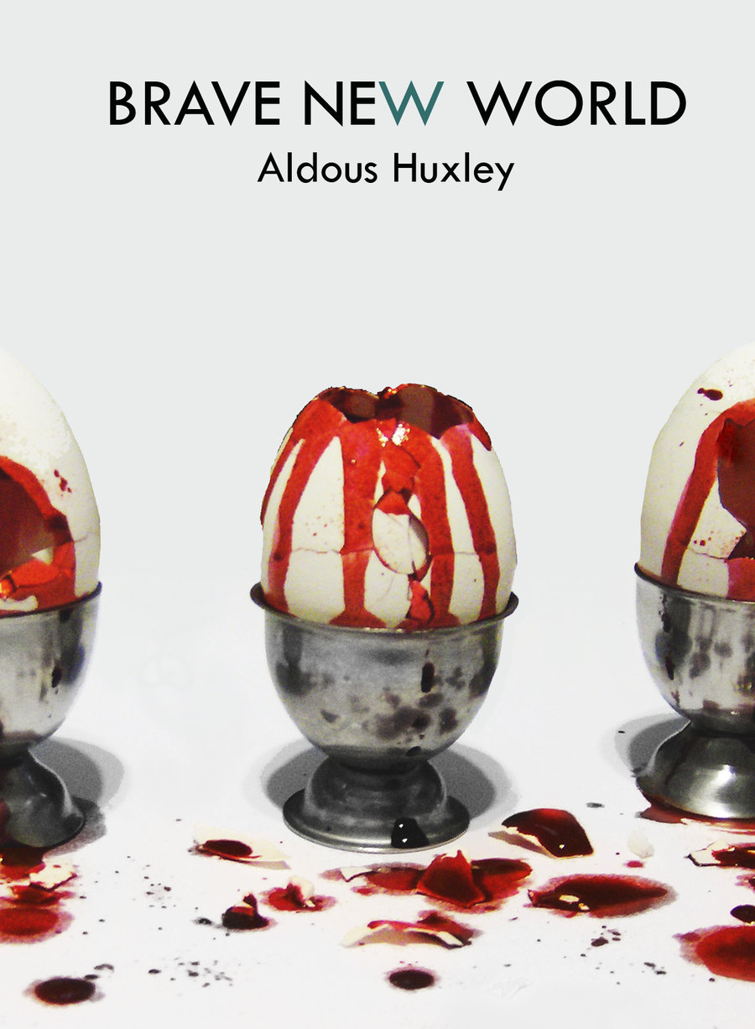
BRAVE NEW WORLD by
Aldous Huxley
(1894-1963)

Slide 72
Chapter One
A SQUAT grey building of only thirty-four stories. Over the main entrance the words, CENTRAL LONDON HATCHERY AND CONDITIONING CENTRE, and, in a shield, the World State's motto, COMMUNITY, IDENTITY, STABILITY.
The enormous room on the ground floor faced towards the north. Cold for all the summer beyond the panes, for all the tropical heat of the room itself, a harsh thin light glared through the windows, hungrily seeking some draped lay figure, some pallid shape of academic goose-flesh, but finding only the glass and nickel and bleakly shining porcelain of a laboratory.
Wintriness responded to wintriness.
The overalls of the workers were white, their hands gloved with a pale corpse-coloured rubber. The light was frozen, dead, a ghost. Only from the yellow barrels of the microscopes did it borrow a certain rich and living substance, lying along the polished tubes like butter, streak after luscious streak in long recession down the work tables.

Slide 73
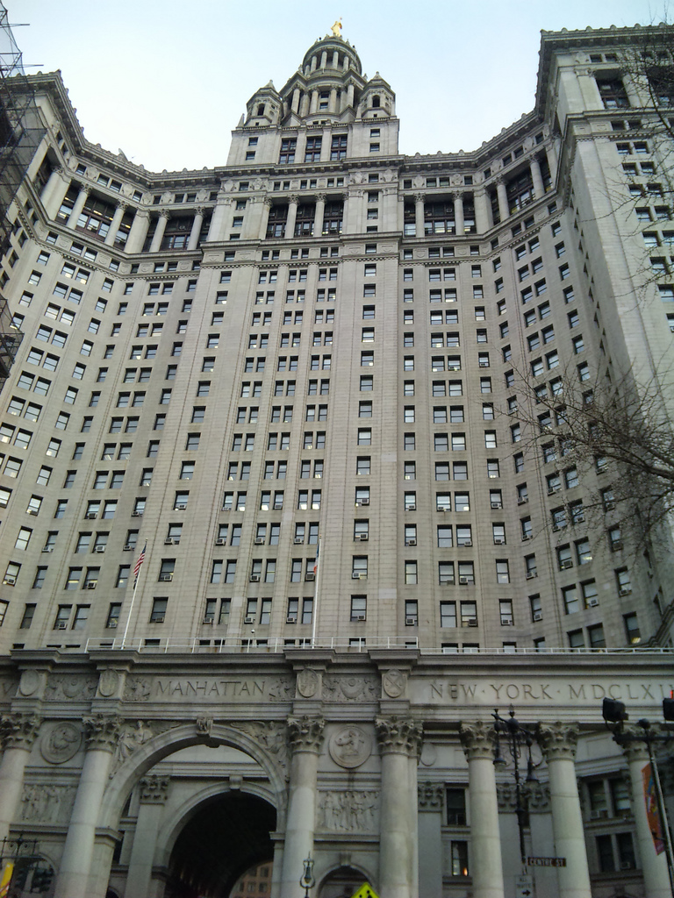

Slide 74
Brave New World
Hidden Curriculum:
  You can only decide WHO you are, if you understand WHERE you come from.
  Your context will define you, if you can’t define it.

Slide 75
Personal Narratives
Hidden Curriculum:
  When you write out what happened, it loses its sting. It becomes a series of symbols on a page. A page that can be burned, or shared, or stapled to a doorway in the night.
  When your story is written out, you control it. It doesn’t control you.

Slide 76
LADY MACBETH
Did you send to him, sir?
MACBETH
I hear it by the way; but I will send.
There’s not a one of them but in his house
I keep a servant fee’d. I will tomorrow—
And betimes I will—to the weird sisters.
More shall they speak, for now I am bent to know,
By the worst means, the worst. For mine own good,
All causes shall give way. I am in blood
Stepped in so far that, should I wade no more,
Returning were as tedious as go o'er.
Strange things I have in head, that will to hand,
Which must be acted ere they may be scanned.
LADY MACBETH
Did you send for him, sir?
MACBETH
I’ve heard about this indirectly, but I will send for him. In every one of the lords' households I have a servant paid to spy for me. Tomorrow, while it’s still early, I will go see the witches. They will tell me more, because I’m determined to know the worst about what’s going to happen. My own safety is the only important thing now. I have walked so far into this river of blood that even if I stopped now, it would be as hard to go back to being good as it is to keep killing people. I have some schemes in my head that I’m planning to put into action. I have to do these things before I have a chance to think about them.

Slide 77
Macbeth
Hidden Curriculum:
  Understanding right and wrong DO NOT prevent people from doing bad things.
  Your choice matters more than your intentions.
  What you CAN do matters infinitely less than what you ACTUALLY DO.
  Don’t be too hasty to take advice at face value. Especially if, you know, it’s a bunch of witches.

Slide 78
The Last Lecture
Hidden Curriculum:
  Nope!
  The Last Lecture lays it out pretty plainly.
  Definitely nothing here for teachers.
  No hidden lessons about hiding real messages in your curriculum. Nosiree!
  Definitely nothing about:
    Treating your class like a game or
    Teaching like the captain of a Space-Ship or
    Putting brick walls in front of students to protect them or
    Showing someone you love them by telling them they are doing the wrong thing or
    Pursuing your dreams, even if they are crazy, even if life takes a big old dump on you now and then and kicks you while you’re down.

Slide 79
So that brings us to…
Last Lecture Project
Due Final Week of School
A 20-40 slide PPT on your experiences at Phoenix
Must include images
Must have a background song to play
  Either embedded or via a link

